Slide 1
Formal Methods in Software Engineering
Weakest pre-conditions and towards machine consistency

Slide 2
Outline
Proof Obligations of
Invariant
Initialization
Operation

Slide 3
Proof Obligations
A proof obligation is a mathematical formula to be proven, in order to ensure that a B component is correct.

Slide 4
Consistency of INVARIANT
For some values of list of variables of the machine for which the INVARIANT clause I is true.
Ticket machine invariant states that
next> serve
This can be demonstrated easily by serve=0 and next=0.

Slide 5
Proof Obligation for Initialization

Slide 6
[T]I
It is necessary to establish that the initial state obtained by executing the INITIALISATION clause T, meets the invariant I.
This means that T must always be guaranteed to establish I or [T]I must be true.
Exercise

Slide 7
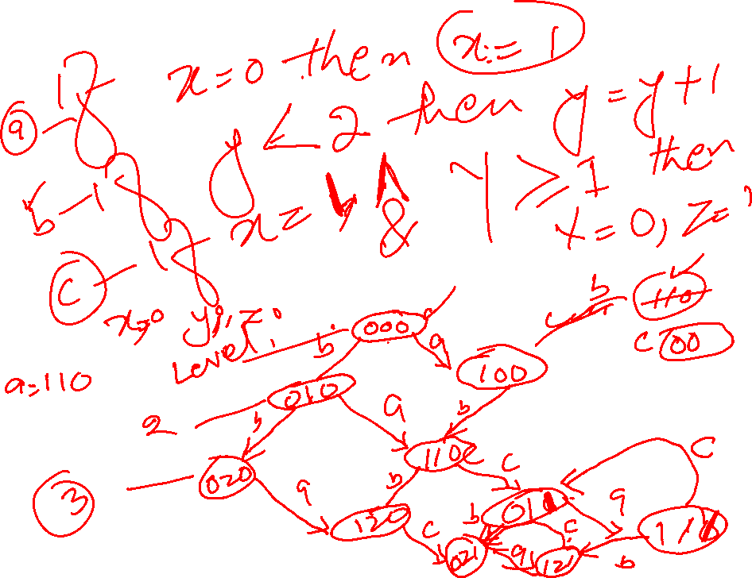
Proof Obligation for Operations

Slide 8
Proof Obligation for Operations
$$I˄P⇒\left[S\right]I$$

Slide 9
B is a method for specifying, designing, and coding software systems.
Jean-Raymond Abrial

Slide 10
Inconsistency
An operation whose proof obligation is not true, highlights a confusion between the machine invariant and the operation.
It needs to be resolved.
Number of ways to resolve a machine inconsistency.
By Strengthening the precondition.
May be Body of the operation might not be correct.
May be Invariant may be too loose that allowed some states that should not be permitted.
Invariant may be wrong.

Slide 11
Case study: Machine Paperround
A machine paperround is used to keep track of the houses in a street, numbered from 1 to 163, which have papers delivered as part of a paper round. Some houses which receives papers also have magazines delivered. The total number of houses on the round is no more than 60.
The machine also keeps track of houses which receive magazines and the requirement for magazine is that only those houses will receive magazines which receive paper.

Slide 12
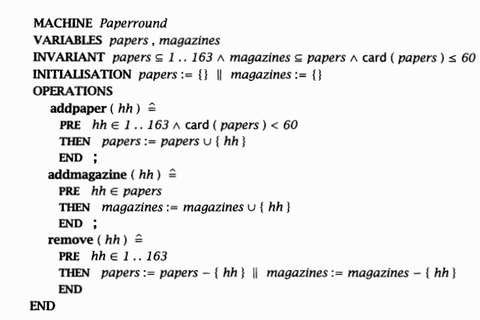

Slide 13
Write the operation addpaper that permits a house to be added to the set papers, provided the size of the set is not at its limit of 60.Observe that this operation can be called even with a house which is already in papers, in which case the adding of house does not changes the state of machine.
Write the operation addmagazine that allows a house to be added to the set which receive magazines, provided that house is already in the set papers.
Write the remove operation that removes a house from the round. The result is the house being removed from both the set papers and magazines.

Slide 14



Exercise

Slide 15



Slide 16
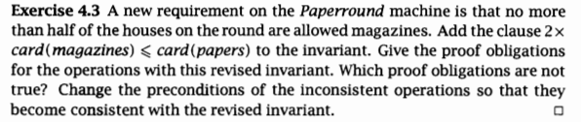
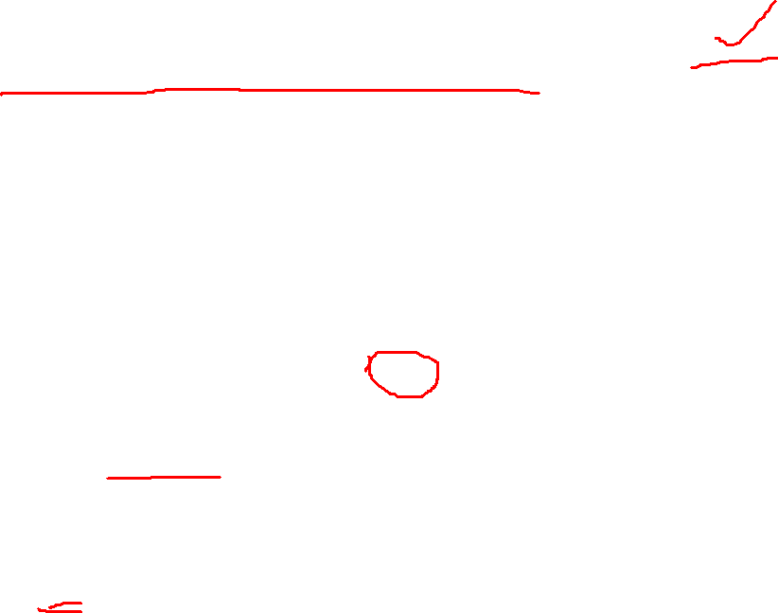

Slide 17

Query operations
It provides some information about state of the machine.
It does not alter the state, so the query opeartions are always consistent.

Slide 18
Summary
Multiple assignment statements can also be used to show parallel execution of statements.
Evaluation of pre conditions using conditional and case statements.
Proof obligations of initialization and Operations

